Slide 1
IRGE Committee Meeting
July 17, 2020
Erica Crew, Margaret diZerega, and Jacqueline Altamirano Marin

Slide 2
The Vera Institute of Justice
Mission
To drive change. To urgently build and improve justice systems that ensure fairness, promote safety, and strengthen communities.
How We Work
Vera works in partnership with local, state, and national government officials to create change from within.
      We study problems that impede human dignity and justice.
      We pilot solutions that are at once transformative and achievable.
      We engage diverse communities in informed debate.
      We harness the power of evidence to drive effective policy and practice.

Slide 3
Goals of Opening Doors
Safely increase access to housing for people with criminal histories
Promote collaboration between PHAs, law enforcement, and other stakeholders to reduce crime and improve reentry outcomes for people leaving prison and jail
Improve the safety of public housing and surrounding communities through reentry housing strategies

Slide 4
Housing Authority Partnerships
California: Six PHAs in the County of San Diego
Colorado: Department of Local Affairs, Division of Housing
Delaware: Five PHAs that make up the state
Illinois: Winnebago County Housing Authority
Louisiana: Lafayette Housing Authority and New Orleans Housing Authority
Massachusetts: Springfield Housing Authority
Michigan: Detroit Housing Commission
Nebraska: Kearney Housing Agency
New York: New York City Housing Authority
North Carolina: Asheville Housing Authority and Burlington Housing Authority
Oklahoma: Oklahoma City Housing Authority
Pennsylvania: Allegheny County Housing Authority
Rhode Island: Providence Housing Authority
Washington: Tacoma Housing Authority

Slide 5
The Foundational Role of Housing
Public Safety
Employment
Stable Housing and Family Support
Health

Slide 6
New York City Housing Authority
Family Reentry Program
Family Reentry Program is designed to provide housing access to people who’ve recently been recently released from prison, jail, or a juvenile facility and want to move in with family in public housing.
Participants are granted temporary permission to live with their families for two years and receive reentry services. Rent does not change for two years.
Upon successful completion of two year program, participants are eligible to be added to a family’s lease.
Supportive services provided by 13 reentry service providers
Other partners include Department of Corrections and Community Supervision, Department of Homeless Services, and Corporation for Supportive Housing

Slide 7
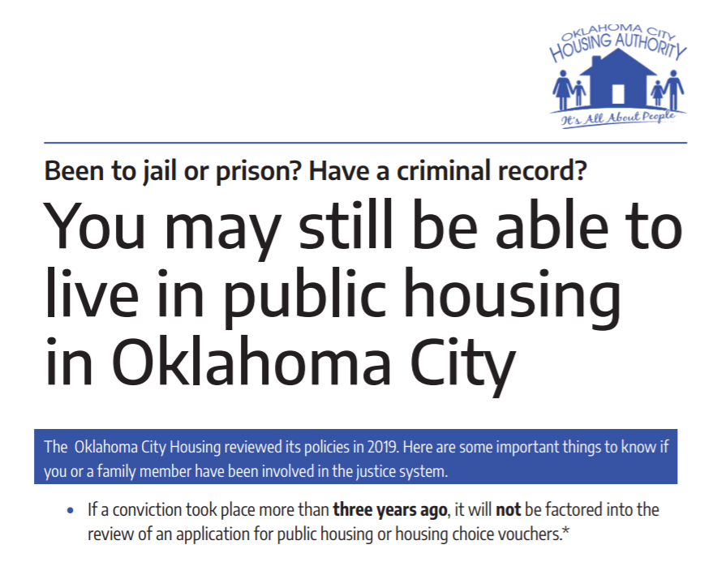
Admissions Policy Changes

Slide 8
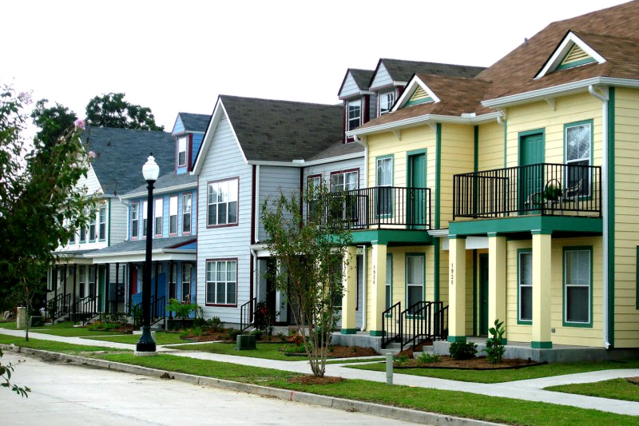
Expanding Housing Eligibility
“There is absolutely no presumption that an applicant with a criminal conviction should be denied housing assistance…”
- Housing Authority of New Orleans

Slide 9
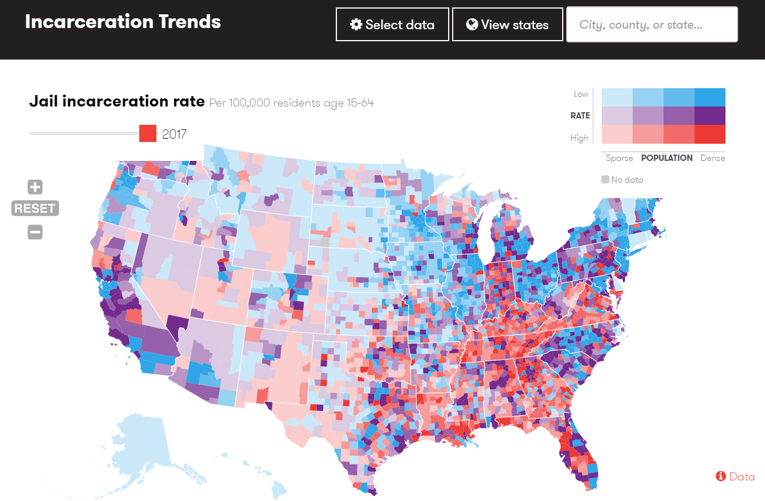
trends.vera.org

